Slide 1
Name: Tejas Palwe
Branch: SE
Roll No: 202190019
Subject: Advance Encryption Standard(AES)

Slide 2
Advance Encryption Standard
(Algorithm) (sms) authentication by one time password
AES is an encryption standard chosen by the National Institute of Standards and Technology(NIST), USA to protect classified information.
It is a block cipher which operates on block size of 128 bits for both encrypting as well as decrypting.
Each Round performs same operations. An input key is also required input to the aes algorithm same size of the plain text.

Slide 3
Problem Statement
The ever increasing social media and online purchase activities in cyber world has created a phenomenon.
Where there are certain individuals or interest groups use it to benefit themselves or disadvantage the others, by registering fake accounts or bots, thus enabling these irresponsible actors to do improper acts, such as deception, insult, defamation.
Falsified support, even black campaign during presidential election.

Slide 4
Working of Algorithm
AES basically repeats 4 major functions to encrypt data.It takes 128 bit block of data and a key and gives a ciphertext as output.
The functions are:
Sub Bytes
Shift Rows
Mix Columns
Add Key

Slide 5
OTP MESSAGE GENERATION PROCESS
Activation msg#ab2ef
Timestamp
ab2e4f5G7Vmk1VAdpU5F8M
Activation_msg#
Authentication
Code
Authentica tion Code “ab2e4f”
AE
KEY
User
Cipertext

Slide 6
ONE TIME PASSWORD ENCRYPTION
Message | Timestamp OTP | Combine | MD5 Combine | OTP
Hallo | 12485046 | hallo12485 046 | b6bd541f6198900ce 703379 | b6bd5
Hallo | 12485047 | hallo12485 047 | aa94894ff7c66e9a8b 24f95d | aa948
Hallo | 12485048 | hallo12485 048 | b1cdb9995454a2bd7 316a645 | b1cdb
Hallo | 12485049 | hallo12485 049 | db2ae1c7e4c2de3c1 be7783f4 | db2ae

Slide 7
USER DECRYPTION PROCESS
User
Authentication
Code
User Password
Authentication Code
“ab2e4f”
ab2e4f5G7Vmk1VAdpU5F8M
AE
Activation_msg
Decryption Result
ex :active#ab2ef#1442445108
Timestamp

Slide 8
SOLUTION ON SERVER SIDE PROCESS
b2e4fa5G7Vmk1VAdpU5F8M
Activation msg
(ab2ef)
Authentication
Code
+
Password
Activation+otp
Authentica tion Code “ab2e4f”
Activation_msgi#b2efa
AE
User
KEY
Cipertext

Slide 9
SOLUTION USER DECRYPTION PROCESS
User
Authentication
Code
User Password
Authentication Code
“b2e4fa”
b2e4fa5G7Vmk1VAdpU5F8M
AE
User
Other operation
Password
+
OTP
Operation#
ab2e4f

Slide 10
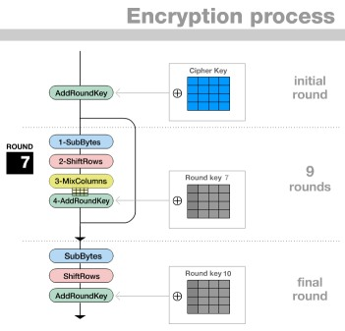
Steps Perform by Algorithm

Slide 11
Real Time Application
Apple company uses Aes algorithm for storing user health related data and biometric information of user.
SanDisk secure access uses Aes algorithm to create a password-protected folder on the flash drive.
Whatsapp use Aes algorithm to achieve for end to end encryption mechanism.
Telegram also uses Aes for secure communication between end users.

Slide 12
References:-
1. SMS Authentication Code Generated by Advance Encryption Standard (AES) 256 bits Modification Algorithm and One Time Password (OTP) to Activate New Applicant Account
2. A Comparative Analysis of AES Common Modes of Operation .
3. Advanced Encryption Standard (AES) Security Enhancement using Hybrid Approach
4. Image Steganography Based on AES Algorithm with Huffman Coding for Compression on Grey Images

Slide 13
Thank you

